Slide 1
9 – Functions and Modules

Slide 2
Admin: Test 1
Marked (released last week)
One-to-one debriefs, you can
Look at your script
Look at mark scheme
Check accuracy of marking
ask questions
Cannot question marking scheme
Can question consistency of marking

Slide 3
Questions: Parameters
Consider the following code: function Move(obj, dist){ obj.style.left = parseInt(obj.style.left) + dist; obj.style.top = parseInt(obj.style.top) + dist; } Move(imgShip, 25);
Name a formal parameter
Name an actual parameter
obj dist
imgShip
25

Slide 4
Session Aims & Objectives
Aims, to introduce:
the idea of a function as a way to make code shorter and easier to understand
the idea of modules as a way to split up large programs and share code between pages
Objectives, by end of this week’s sessions, you should be able to:
create your own function definitions
call these functions
appropriately split a program into multiple modules
reuse modules in several pages/programs

Slide 5
Example: Interceptor (analysis)
SPECIFICATION
User Requirements
to be entertained
Software Requirements
Functional:
display image of space ship, which can be moved using the left and right arrow keys
display images of asteroids, which the user must block using the space ship (thereby gaining points)
Non-functional should be playable in real time

Slide 6
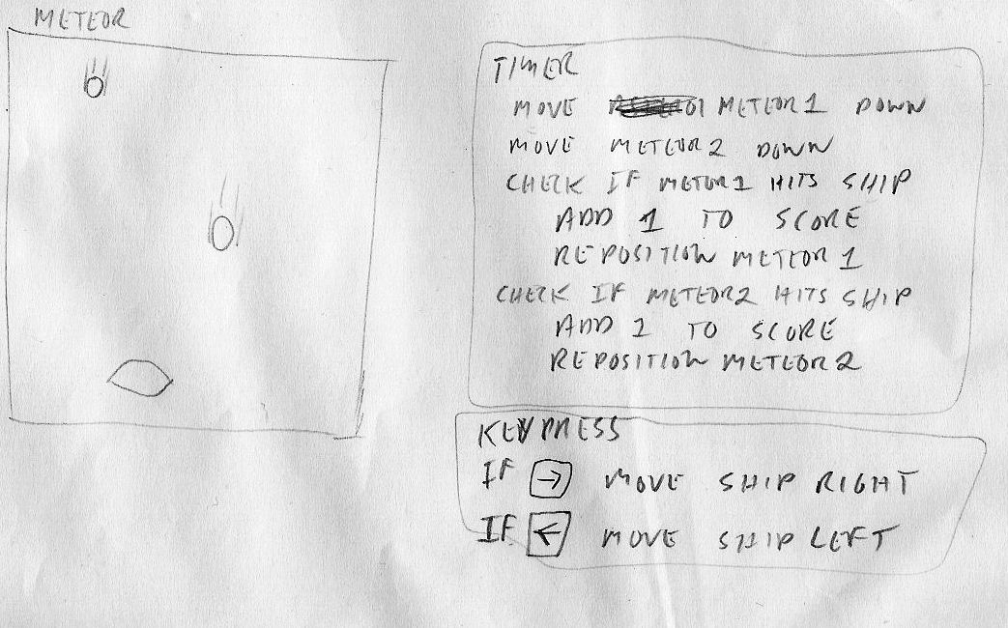
Example: Interceptor (design)
Computer games & simulations work like board games:

Slide 7
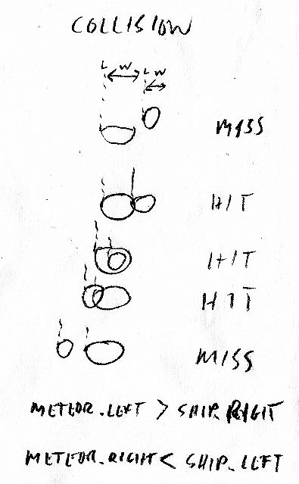
Problem Solving: Collision Detection
2 types of problem:
familiar (seen before – remember solution)
novel (work out solution)
generate algorithm:
solve it on paper
draw diagrams
work through possibilities
ask how did I do that
what steps did I take?

Slide 8
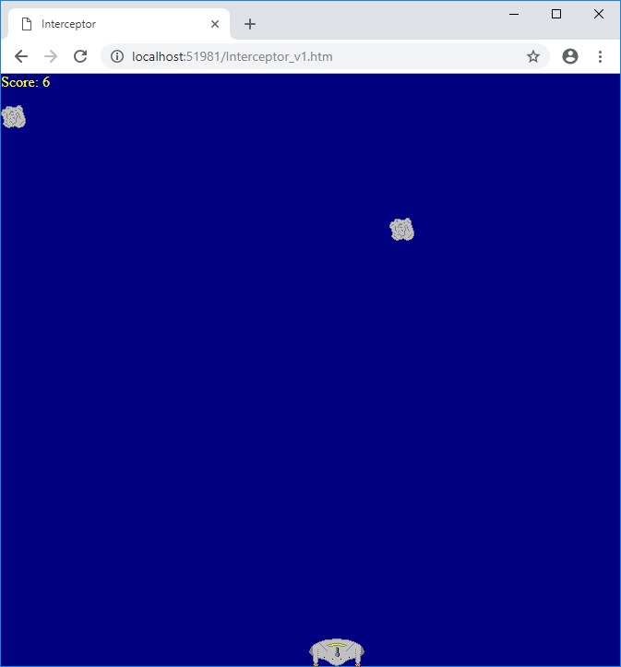
Example: Interceptor (user interface)

Slide 9
Example: Interceptor v1 (code)
var xInc;
var score;
function window_onLoad(){
imgShip.style.left = 0;
imgShip.style.top = document.body.clientHeight - imgShip.height;
imgAst1.style.left = Math.random() * (document.body.clientWidth - imgAst1.width);
imgAst1.style.top = 0;
xInc = 0;
score = 0;
window.setInterval("Main()", 20);
}
function document_onKeyDown(){
switch (window.event.keyCode){
case 37:
xInc = xInc + 2; break;
case 39:
xInc = xInc - 2; break;
}
}
function Main(){
var nxt
nxt = parseInt(imgShip.style.left) - xInc;
if (nxt < 0 || nxt > document.body.clientWidth - imgShip.width){
xInc = -xInc;
}else{
imgShip.style.left = nxt;
}
imgAst1.style.top = parseInt(imgAst1.style.top) + 4;
if ((parseInt(imgAst1.style.top) + imgAst1.height) > document.body.clientHeight){
imgAst1.style.top = 0;
imgAst1.style.left = Math.random() * (document.body.clientWidth - imgAst1.width);
}
if (parseInt(imgAst1.style.top) + imgAst1.height > parseInt(imgShip.style.top)){
if (parseInt(imgAst1.style.left) + imgAst1.width > parseInt(imgShip.style.left)){
if (parseInt(imgAst1.style.left) < parseInt(imgShip.style.left) + imgShip.width){
score = score + 1;
parScore.innerText = "Score: " + score;
imgAst1.style.top = 0;
imgAst1.style.left = Math.random() * (document.body.clientWidth - imgAst1.width);
}
}
}
}
var xInc;
var score;
function window_onLoad(){
imgShip.style.left = 0;
imgShip.style.top = document.body.clientHeight - imgShip.height;
imgAst1.style.left = Math.random() * (document.body.clientWidth - imgAst1.width);
imgAst1.style.top = 0;
xInc = 0;
score = 0;
window.setInterval("Main()", 20);
}

Slide 10
Example: Interceptor v1 (code)
var xInc;
var score;
function window_onLoad(){
imgShip.style.left = 0;
imgShip.style.top = document.body.clientHeight - imgShip.height;
imgAst1.style.left = Math.random() * (document.body.clientWidth - imgAst1.width);
imgAst1.style.top = 0;
xInc = 0;
score = 0;
window.setInterval("Main()", 20);
}
function document_onKeyDown(){
switch (window.event.keyCode){
case 37:
xInc = xInc + 2; break;
case 39:
xInc = xInc - 2; break;
}
}
function Main(){
var nxt
nxt = parseInt(imgShip.style.left) - xInc;
if (nxt < 0 || nxt > document.body.clientWidth - imgShip.width){
xInc = -xInc;
}else{
imgShip.style.left = nxt;
}
imgAst1.style.top = parseInt(imgAst1.style.top) + 4;
if ((parseInt(imgAst1.style.top) + imgAst1.height) > document.body.clientHeight){
imgAst1.style.top = 0;
imgAst1.style.left = Math.random() * (document.body.clientWidth - imgAst1.width);
}
if (parseInt(imgAst1.style.top) + imgAst1.height > parseInt(imgShip.style.top)){
if (parseInt(imgAst1.style.left) + imgAst1.width > parseInt(imgShip.style.left)){
if (parseInt(imgAst1.style.left) < parseInt(imgShip.style.left) + imgShip.width){
score = score + 1;
parScore.innerText = "Score: " + score;
imgAst1.style.top = 0;
imgAst1.style.left = Math.random() * (document.body.clientWidth - imgAst1.width);
}
}
}
}
function document_onKeyDown(){
switch (window.event.keyCode){
case 37:
xInc = xInc + 2; break;
case 39:
xInc = xInc - 2; break;
}
}

Slide 11
Example: Interceptor v1 (code)
var xInc;
var score;
function window_onLoad(){
imgShip.style.left = 0;
imgShip.style.top = document.body.clientHeight - imgShip.height;
imgAst1.style.left = Math.random() * (document.body.clientWidth - imgAst1.width);
imgAst1.style.top = 0;
xInc = 0;
score = 0;
window.setInterval("Main()", 20);
}
function document_onKeyDown(){
switch (window.event.keyCode){
case 37:
xInc = xInc + 2; break;
case 39:
xInc = xInc - 2; break;
}
}
function Main(){
var nxt
nxt = parseInt(imgShip.style.left) - xInc;
if (nxt < 0 || nxt > document.body.clientWidth - imgShip.width){
xInc = -xInc;
}else{
imgShip.style.left = nxt;
}
imgAst1.style.top = parseInt(imgAst1.style.top) + 4;
if ((parseInt(imgAst1.style.top) + imgAst1.height) > document.body.clientHeight){
imgAst1.style.top = 0;
imgAst1.style.left = Math.random() * (document.body.clientWidth - imgAst1.width);
}
if (parseInt(imgAst1.style.top) + imgAst1.height > parseInt(imgShip.style.top)){
if (parseInt(imgAst1.style.left) + imgAst1.width > parseInt(imgShip.style.left)){
if (parseInt(imgAst1.style.left) < parseInt(imgShip.style.left) + imgShip.width){
score = score + 1;
parScore.innerText = "Score: " + score;
imgAst1.style.top = 0;
imgAst1.style.left = Math.random() * (document.body.clientWidth - imgAst1.width);
}
}
}
}
function Main(){
var nxt
nxt = parseInt(imgShip.style.left) - xInc;
if (nxt < 0 || nxt > document.body.clientWidth - imgShip.width){
xInc = -xInc;
}else{
imgShip.style.left = nxt;
}
imgAst1.style.top = parseInt(imgAst1.style.top) + 4;
if ((parseInt(imgAst1.style.top) + imgAst1.height) > document.body.clientHeight){
imgAst1.style.top = 0;
imgAst1.style.left = Math.random() * (document.body.clientWidth - imgAst1.width);
}
if (parseInt(imgAst1.style.top) + imgAst1.height > parseInt(imgShip.style.top)){
if (parseInt(imgAst1.style.left) + imgAst1.width > parseInt(imgShip.style.left)){
if (parseInt(imgAst1.style.left) < parseInt(imgShip.style.left) + imgShip.width){
score = score + 1;
parScore.innerText = "Score: " + score;
imgAst1.style.top = 0;
imgAst1.style.left = Math.random() * (document.body.clientWidth - imgAst1.width);
}
}
}
}

Slide 12
Problem: Repeated Calculations
implementation (code)
more complicated than algorithm
technical detail (how)
e.g. right = left + width
if (parseInt(imgAst1.style.top) + imgAst1.height > parseInt(imgShip.style.top)){
if (parseInt(imgAst1.style.left) + imgAst1.width > parseInt(imgShip.style.left)){
if (parseInt(imgAst1.style.left) < parseInt(imgShip.style.left) + imgShip.width){
score = score + 1;
parScore.innerText = "Score: " + score;
imgAst1.style.top = 0;
imgAst1.style.left = Math.random() * (document.body.clientWidth - imgAst1.width);
}
}
}

Slide 13
Procedures and Functions
Both Procedures and Functions
Group of statements
Identified by unique name
mirror real life activities
Procedures – just do something
Functions – return a value
used to perform calculations

Slide 14
Built in Functions
Sqr – gives square root of a number:
Sqrt(16) returns 4
Sqrt(9) returns 3
Sqrt(4) returns 2
Math.random() – generates random numbers between 0 and 0.99999999…
subStr, length…

Slide 15
User Defined Functions (how)
Syntax very similar to procedure definition: function name(parameters){ Statementblock return value; }
where
name represents function’s name (you choose)
parameters represent information needed
value represent the return value

Slide 16
Functions: FtoC
The declaration:
function FtoC(f){
return ((f-32) * 5) / 9;
}
The call:
parRes.innerText = FtoC(50)

Slide 17
Functions: Fahrenheit to Celsius

Slide 18
Functions: Largest
What will first and second contain?

Slide 19
Questions: Functions
Consider the following code:
var b;
b = 12;
function Twice(num){
return num * 2;
}
What do the following return:
Twice(6)
Twice(b)
12
24

Slide 20
Example: Interceptor v2
Function makes code easier to read (closer to pseudo-code / algorithm):
if (parseInt(imgAst1.style.top) + imgAst1.height > parseInt(imgShip.style.top)){
if (Right(imgAst1) > parseInt(imgShip.style.left)){
if (parseInt(imgAst1.style.left) < Right(imgShip)){
score = score + 1;
parScore.innerText = "Score: " + score;
imgAst1.style.top = 0;
imgAst1.style.left = Math.random() * (document.body.clientWidth - imgAst1.width);
}
}
}
}
function Right(obj){
return parseInt(obj.style.left) + obj.width;
}

Slide 21
Question: Function Headers
Write the first line of a function definition to convert pounds to euros:
Write the first line of a function definition to convert minutes and hours to minutes:
function Euros(Pounds)
function Minutes(Mins, Hours)

Slide 22
Example: Interceptor v3
…
if(ShipCollide(imgAst1)){
score = score + 1;
parScore.innerText = "Score: " + score;
imgAst1.style.top = 0;
imgAst1.style.left = Math.random() * (document.body.clientWidth - imgAst1.width);
}
}
function ShipCollide(obj1){
if (parseInt(obj1.style.top) + obj1.height > parseInt(imgShip.style.top)){
if (Right(obj1) > parseInt(imgShip.style.left)){
if (parseInt(obj1.style.posLeft) < Right(imgShip)){
return true;
}
}
}
return false;
}
function Right(obj){
return parseInt(obj.style.left) + obj.width;
}

Slide 23
Question: Functions
Write a function that converts kilometres to miles (divide the number of kilometres by 1.6 to get miles):
function Miles(km){
return km / 1.6;
}

Slide 24
Functions: Total

Slide 25
Problem: Interceptor
var xInc;
var score;
function window_onLoad(){
imgShip.style.left = 0;
imgShip.style.top = document.body.clientHeight - imgShip.height;
imgAst1.style.left = Math.random() * (document.body.clientWidth - imgAst1.width);
imgAst1.style.top = 0;
xInc = 0;
score = 0;
window.setInterval("Main()", 20);
}
function document_onKeyDown(){
switch (window.event.keyCode){
case 37:
xInc = xInc + 2; break;
case 39:
xInc = xInc - 2; break;
}
}
function Main(){
var nxt
nxt = parseInt(imgShip.style.left) - xInc;
if (nxt < 0 || nxt > document.body.clientWidth - imgShip.width){
xInc = -xInc;
}else{
imgShip.style.left = nxt;
}
imgAst1.style.top = parseInt(imgAst1.style.top) + 4;
if ((parseInt(imgAst1.style.top) + imgAst1.height) > document.body.clientHeight){
imgAst1.style.top = 0;
imgAst1.style.left = Math.random() * (document.body.clientWidth - imgAst1.width);
}
if (parseInt(imgAst1.style.top) + imgAst1.height > parseInt(imgShip.style.top)){
if (parseInt(imgAst1.style.left) + imgAst1.width > parseInt(imgShip.style.left)){
if (parseInt(imgAst1.style.left) < parseInt(imgShip.style.left) + imgShip.width){
score = score + 1;
parScore.innerText = "Score: " + score;
imgAst1.style.top = 0;
imgAst1.style.left = Math.random() * (document.body.clientWidth - imgAst1.width);
}
}
}
}
var xInc;
var score;
function window_onLoad(){
imgShip.style.left = 0;
imgShip.style.top = document.body.clientHeight - imgShip.height;
imgAst1.style.left = Math.random() * (document.body.clientWidth - imgAst1.width);
imgAst1.style.top = 0;
xInc = 0;
score = 0;
window.setInterval("Main()", 20);
}
function document_onKeyDown(){
switch (window.event.keyCode){
case 37:
xInc = xInc + 2; break;
case 39:
xInc = xInc - 2; break;
}
}
function Main(){
var nxt
nxt = parseInt(imgShip.style.left) - xInc;
if (nxt < 0 || nxt > document.body.clientWidth - imgShip.width){
xInc = -xInc;
}else{
imgShip.style.left = nxt;
}
imgAst1.style.top = parseInt(imgAst1.style.top) + 4;
if ((parseInt(imgAst1.style.top) + imgAst1.height) > document.body.clientHeight){
imgAst1.style.top = 0;
imgAst1.style.left = Math.random() * (document.body.clientWidth - imgAst1.width);
}
if(ShipCollide(imgAst1)){
score = score + 1;
parScore.innerText = "Score: " + score;
imgAst1.style.top = 0;
imgAst1.style.left = Math.random() * (document.body.clientWidth - imgAst1.width);
}
}
function ShipCollide(obj1){
if (parseInt(obj1.style.top) + obj1.height > parseInt(imgShip.style.top)){
if (Right(obj1) > parseInt(imgShip.style.left)){
if (parseInt(obj1.style.left) < Right(imgShip)){
return true;
}
}
}
return false;
}
function Right(obj){
return parseInt(obj.style.left) + obj.width;
}
Code is longer (but easier to read)

Slide 26
Modules
Projects can contain many modules/units
web pages (*.htm)
js script file (*.js)
Modules
divide your code into separate parts
available to other pages and modules, using: <script src="Interceptor.js"></script>

Slide 27
Example: Interceptor v4
Interceptor.htm
<script src="Interceptor_v4.js"></script>
<script>
var xInc;
var score;
function window_onLoad(){
imgShip.style.left = 0;
imgShip.style.top = document.body.clientHeight - imgShip.height;
imgAst1.style.left = Math.random() * (document.body.clientWidth - imgAst1.width);
imgAst1.style.top = 0;
xInc = 0;
score = 0;
window.setInterval("Main()", 20);
}
function document_onKeyDown(){
switch (window.event.keyCode){
case 37:
xInc = xInc + 2; break;
case 39:
xInc = xInc - 2; break;
}
}
function Main(){
var nxt
nxt = parseInt(imgShip.style.left) - xInc;
if (nxt < 0 || nxt > document.body.clientWidth - imgShip.width){
xInc = -xInc;
}else{
imgShip.style.left = nxt;
}
imgAst1.style.top = parseInt(imgAst1.style.top) + 4;
if ((parseInt(imgAst1.style.top) + imgAst1.height) > document.body.clientHeight){
imgAst1.style.top = 0;
imgAst1.style.left = Math.random() * (document.body.clientWidth - imgAst1.width);
}
if(ShipCollide(imgAst1)){
score = score + 1;
parScore.innerText = "Score: " + score;
imgAst1.style.top = 0;
imgAst1.style.left = Math.random() * (document.body.clientWidth - imgAst1.width);
}
}
</script>
Interceptor.js
function ShipCollide(obj1){
if (parseInt(obj1.style.top) + obj1.height > parseInt(imgShip.style.top)){
if (Right(obj1) > parseInt(imgShip.style.left)){
if (parseInt(obj1.style.left) < Right(imgShip)){
return true;
}
}
}
return false;
}
function Right(obj){
return parseInt(obj.style.left) + obj.width;
}
js file (module) holds functions and general procedures

Slide 28
Example: Interceptor v5
<script src=Interceptor_v5.js></script>
<script>
var xInc;
var score;
function window_onLoad(){
MoveToBottom(imgShip);
MoveRndHor(imgAst1);
xInc = 0;
score = 0;
window.setInterval("Main()", 20);
}
function document_onKeyDown(){
switch (window.event.keyCode){
case 37:
xInc = xInc + 2; break;
case 39:
xInc = xInc - 2; break;
}
}
function Main(){
MoveShip();
MoveDown(imgAst1, 4);
if (AtBottom(imgAst1)){
MoveRndHor(imgAst1);
}
if (HitShip(imgAst1)){
IncreaseScore();
MoveRndHor(imgAst1);
}
}
</script>
function MoveToBottom(obj){
obj.style.top = document.body.clientHeight - obj.height;
obj.style.left = 0;
}
function MoveRndHor(obj){
obj.style.top = 0;
obj.style.left = Math.random() * (document.body.clientWidth - obj.width);
}
function MoveDown(obj, dist){
obj.style.top = parseInt(obj.style.top) + dist;
}
function HitShip(obj1){
if (parseInt(obj1.style.top) + obj1.height > parseInt(imgShip.style.top)){
if (Right(obj1) > parseInt(imgShip.style.left)){
if (parseInt(obj1.style.left) < Right(imgShip)){
return true;
}
}
}
return false;
}
function Right(obj){
return parseInt(obj.style.left) + obj.width;
}
function AtBottom(obj){
return (parseInt(obj.style.top) + obj.height) > document.body.clientHeight;
}
function IncreaseScore(){
score = score + 1;
parScore.innerText = "Score: " + score;
}
function MoveShip(){
var nxt;
nxt = parseInt(imgShip.style.left) - xInc;
if (nxt < 0 || nxt > document.body.clientWidth - imgShip.width){
xInc = -xInc;
}else{
imgShip.style.left = nxt;
}
}

Slide 29
Example: Interceptor v5
Main code reads almost like algorithm:
function Main(){
MoveShip
MoveDown imgAst1, 2
if (AtBottom(imgAst1)){
MoveRndHor imgAst1
}
if (HitShip(imgAst1)){
IncreaseScore
MoveRndHor imgAst1
}
}
function Main(){
MoveShip();
MoveDown(imgAst1, 4);
if (AtBottom(imgAst1)){
MoveRndHor(imgAst1);
}
if (HitShip(imgAst1)){
IncreaseScore();
MoveRndHor(imgAst1);
}
}

Slide 30
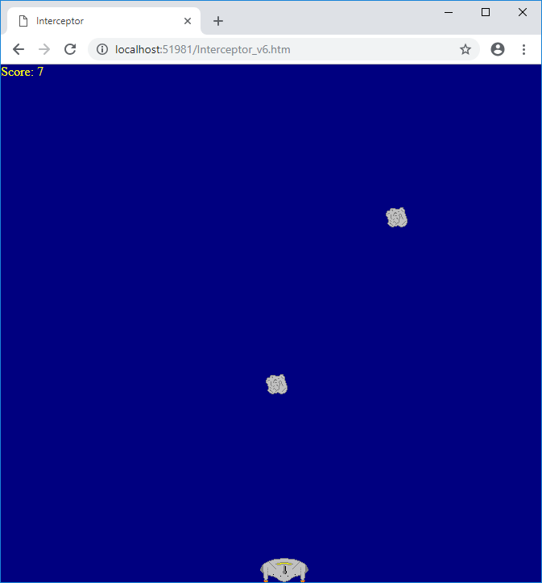
Example: Interceptor v6
Functions and Procedures
benefits when code gets larger
easy to add extra asteroid

Slide 31
Sharing Modules
Clock
Orbit
function window_onLoad(){
var ang;
var s;
var i;
s = "";
for (i = 1; i <= 12; i++){
s = s + "<div id=div" + i + " style='position: absolute;'>" + i + "</div>";
}
document.body.innerHTML = s + document.body.innerHTML;
imgMid.style.left = document.body.clientWidth / 2;
imgMid.style.top = document.body.clientHeight / 2;
ang = 6.2 / 12;
for (i=1; i<=12; i++){
Position(document.getElementById("div" + i), ang * i);
}
window.setInterval("ShowHands()", 500);
}
function ShowHands(){
var ang;
var s;
ang = 6.2 / 60;
s = new Date().getSeconds();
Position(imgSec,ang * s);
}
function Position(objO, a){
objO.style.left = parseInt(imgMid.style.left) + Math.sin(a) * 200;
objO.style.top = parseInt(imgMid.style.top) - Math.cos(a) * 200;
}
var xEarth;
var yEarth;
var angle;
function window_onLoad(){
xEarth = document.body.clientWidth / 2;
yEarth = document.body.clientHeight / 2;
imgEarth.style.left = xEarth;
imgEarth.style.top = yEarth;
imgMoon.style.left = xEarth;
imgMoon.style.top = yEarth + 150;
angle = 0;
window.setInterval("MoveMoon()", 50);
}
function MoveMoon(){
angle = angle + 0.01;
imgMoon.style.left = xEarth + (Math.sin(angle) * 150);
imgMoon.style.top = yEarth + (Math.cos(angle) * 150);
}
2 pages can use same module:

Slide 32
Tutorial Exercises: Interceptor
LEARNING OBJECTIVE:
use functions to shorten your code and make it easier to modify
Task 1: Get the Interceptor example (from the lecture) working.
Task 2: Modify your page to play a suitable sound when the asteroid collides with the ship.
Task 3: Modify your page to have 4 asteroids
Task 4: Modify your page so that the player must avoid the asteroids. Give your player 5 lives (lose a life each time the space craft hits an asteroid).
Task 5: Add an escape pod which the player must pick up (hit) to increase their score.

Slide 33
Tutorial Exercises: Position
LEARNING OBJECTIVE:
use a module file to share code between pages
Task 1: Create a web site that contains copies of your orbit and clock examples.
Task 2: Create a module file containing shared code between the modules for the position procedure.

